Slide 1
On Road Vehicle Assistance finder
BY – SHASHANK SHAKYA (171500312)
SAURABH TYAGI (171500306)

Slide 2
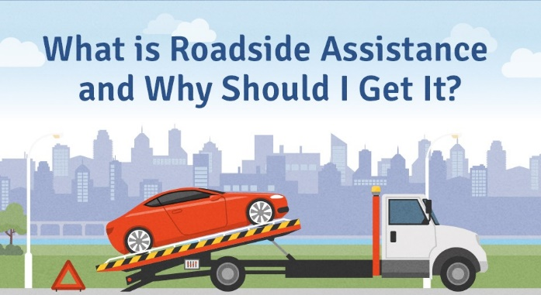

Slide 3
What is On Road Vehicle Breakdown Assistance Finder
Vehicle breakdown is the mechanical failure of a motor vehicle in such a way that the underlying problem prevents the vehicle from being operated at all, or impedes the vehicle's operation so much, that it is very difficult, nearly impossible, or else dangerous to operate.

Slide 4
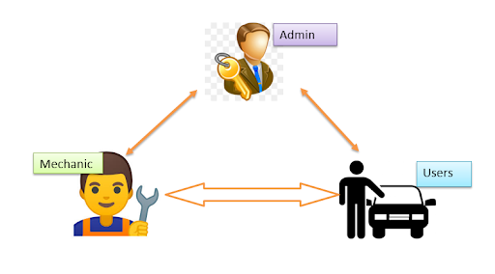
How it works

Slide 5
Working process
When any person trouble from the breakdown of the vehicle at any time ; they can contact with us 24*7 hrs from any place of India.
They can simply login to our website and on their location and fill the problem regarding their vehicle.
We are providing a assistant or mechanic to repair their vehicle.

Slide 6

Insurance Coverage

Slide 7
Advantages
Easy access to the data.
Secure registration of user’s and mechanics.
The new system is more user-friendly, reliable and flexible.
Reduced manual work.
Search mechanics based on different locations.

Slide 8
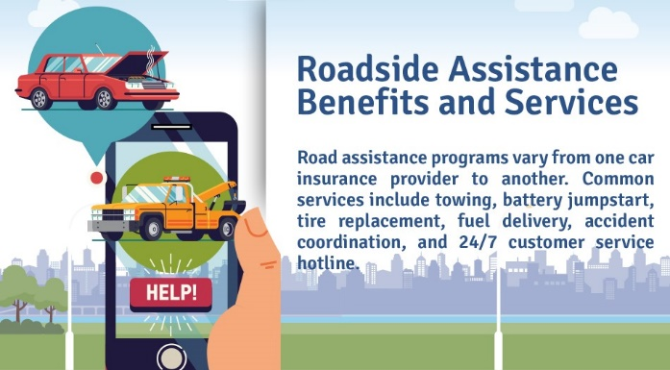
Advantages

Slide 9
Disadvantages
Requires an active internet connection.
System will provide inaccurate results if data not entered properly

Slide 10
Thank you

